Slide 1
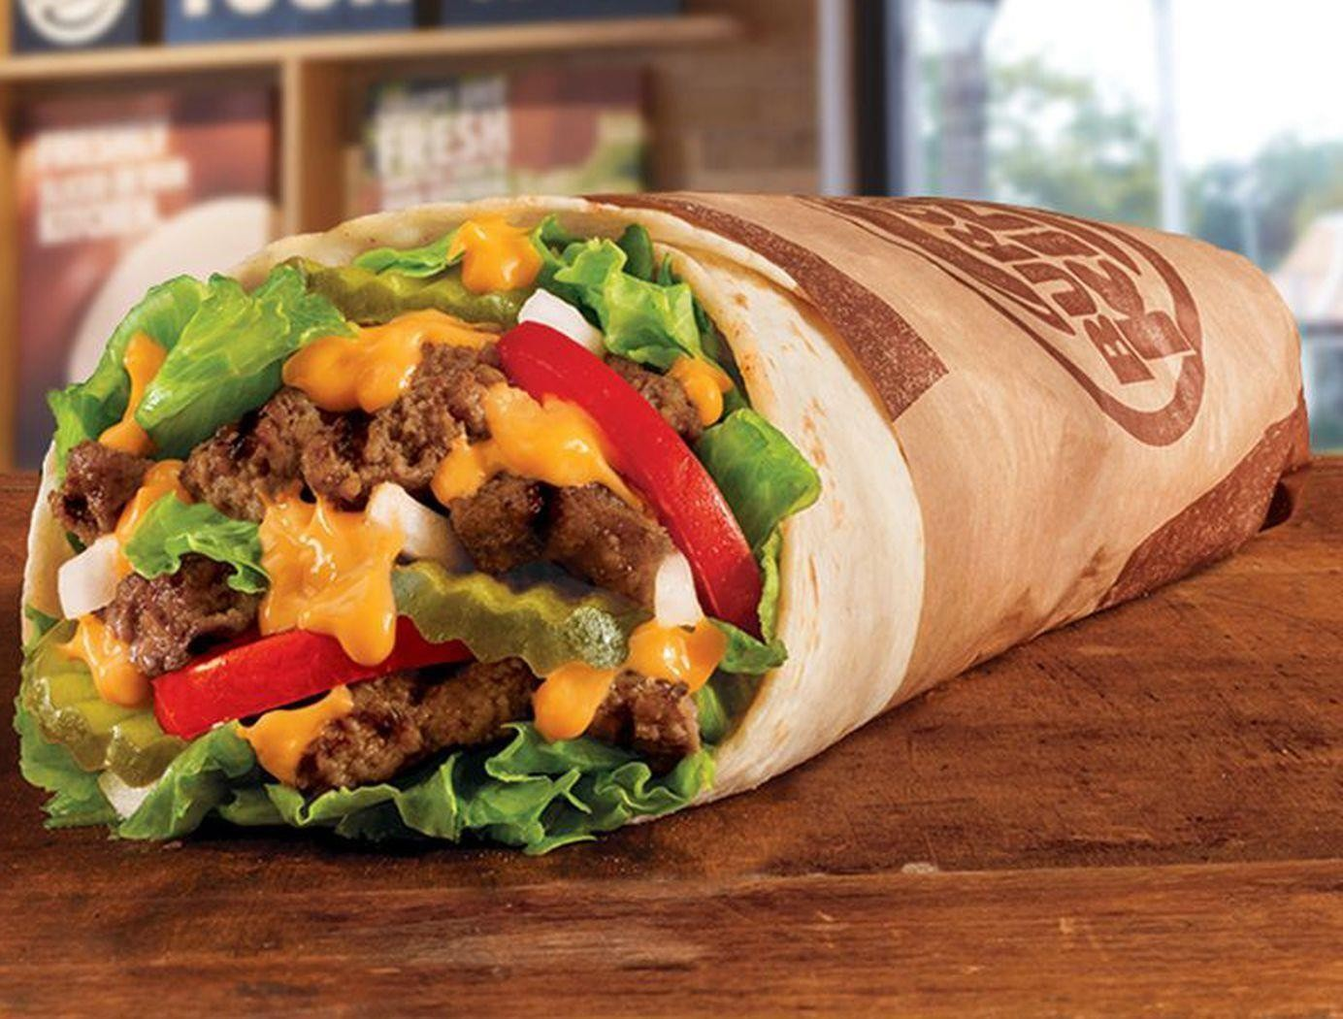
By : Pulleh Bhatia Naman Batra Shubham Hosalikar

Slide 2

Intro to the DataSet
Mexican cuisines are one of the most favored and loved in the parts of southern parts of North America. Out the various food varieties that a typical Mexican restaurant have in their menu, Burritos are more preferred by the average man.
The data set contains over 123 different types of burritos soldover 94 restaurants in the city of San Diego. The data set consists of about 385 rows and 66columns.

Slide 3
There are 10 core dimensions of the San Diego burrito. * Volume * Tortilla quality *Temperature * Meat quality * Non-meat filling quality * Meat-to-filling ratio * Uniformity * Salsa quality * Flavor synergy * Wrapintegrity.
All of these measures (except for Volume) are rated on ascale from 0 to 5, 0 being terrible, and 5 being optimal. It also consists of the google, yelp rating and overall rating of the restaurant. The data set also highlights the ingredients used in particular burrito, which is the key aspect of a good burrito.

Slide 4
DATA CLEANING
The data set doesn't seem to have any outliers. The reason being, almost all columns were ratings out of 5 for each parameter. But, of course, there were missing values and inconsistent data. The overall rating column had some missing values. These values were filled by taking the average of all the individual rating columns that was given by that particular reviewer. Some of the individual columns also had missing ratings. These were filled with the overall rating given by that particular reviewer. These accounted for filling of 10 columns.
Inconsistent data were found in the columns containing the Burrito outlet name and Burrito name. The same place or Burrito were written in different formats. Some were in title case, some in sentence case, some had extra spaces. These would result in considering them as a totally different entity. Therefore, these were cleaned by maintaining a uniform format. The ones that didn't follow the format were formatted into the title case and extra spaces removed.
Apart from these, Google and Yelp columns had incomplete rows which are actually not considered to be missing values because they've rated for only once per outlet whereas there were multiple rows having same outlet. These rows for Google and Yelp were filled with the rating they've given

Slide 5

The Analysis

Slide 6

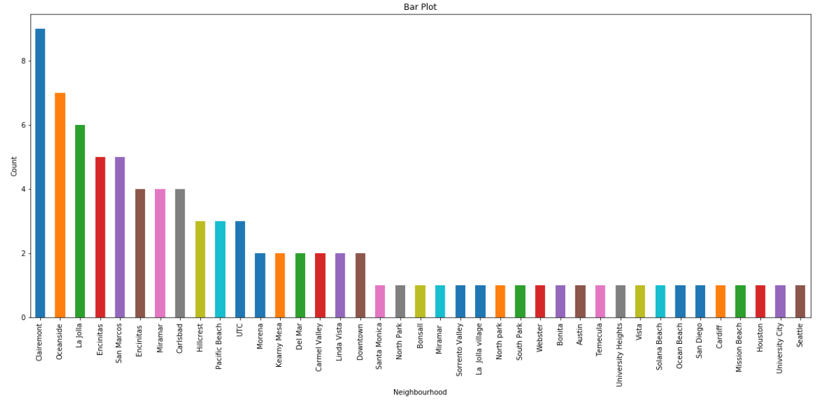
HOWARE RESTAURANTS DISTRIBUTED IN
SAN DIEGO?

Slide 7

INFERENCE
Clearly, there are about 10 restaurants in Clairmount fallowed by 7 in Oceanside and 6 in La Jolla and so on. It is reasonable to think that, if we put up a restaurant in densely populated places, we might face stronger population. Clairmount is therefore not a good place to set up a restaurant.We must look for places having reasonable number of restaurants.

Slide 8

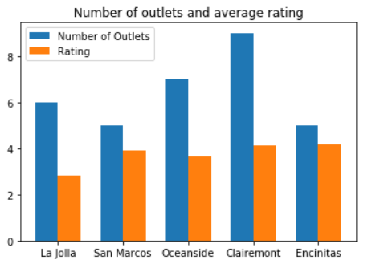
WHATARE THE AVERAGE RATING OF THE RESTAURANTS INA PARTICULAR REGION INA CITY?

Slide 9
INFERENCE
Clearly, the place Clairemont has about 10 outlets and the average rating of these restaurants in the region are relatively high. Therefore, it is not a good place to start a new restaurant. The place Encinitas, even though it has a less number of outlets, they average rating of these restaurants is very high thus supporting our assumption. Observing closely, La Jolla has relatively less number of outlets and the quality of these restaurants is not that great as the average rating of this restaurants is less.
Therefore La Jolla would a better place to start a new restaurant, where we face minimal amount of competition and hence our restaurant has a chance to be recognized in thisarea.

Slide 10

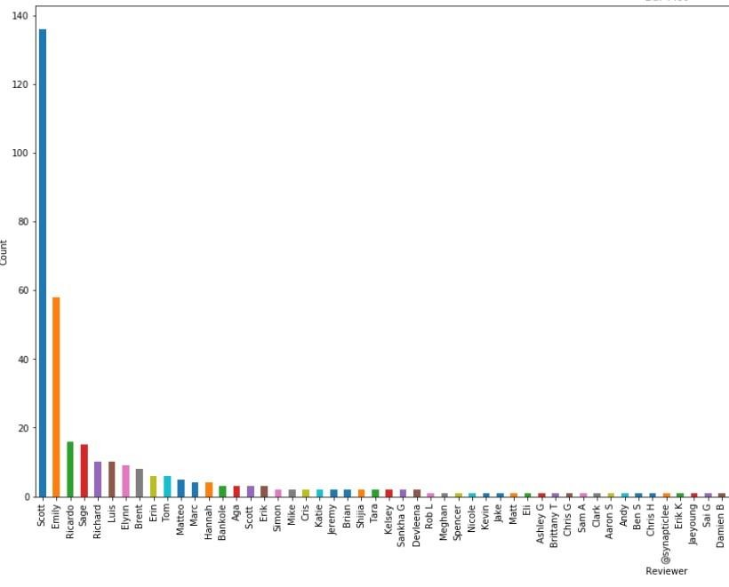
BUT, HOWBELIEVABLE ARE THESE RATINGS OF THE RESTAURANTS? IS THERE A POSSIBILITY OF ANY BIAS INVOLVED?

Slide 11
INFERENCE
Clearly, the person Scott has reviewed almost all the restaurants (particularly burritos from the data set) in the city. Fallowing Scott other people like Emily and Ricardo have reviewed a reasonable number of restaurants. It could be that they are food critics or a foodies who have been reviewing the restaurant’s burritos in the city. The
rest of the reviewers have reviewed only a few of the restaurants (some of them only
one) showing that they belong to the general population (where there can be bias involved).
Therefore, we need to base our menu and on the reviews given by the reviewers and
their reviews need to be taken seriously.

Slide 12

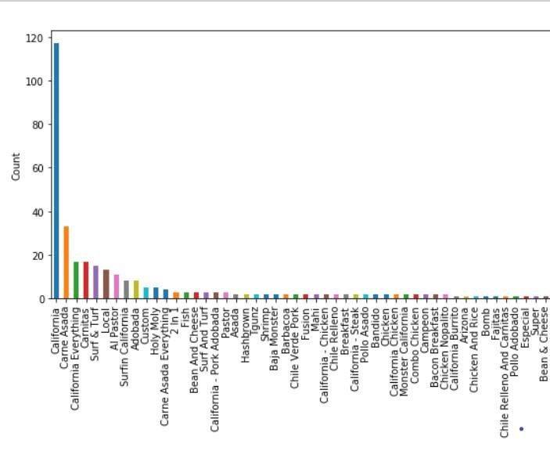
WHATARE MOST FAMOUS BURRITO TYPES
INSAN DIEGO?

Slide 13
INFERENCE
So clearly, we can see from the graph that, the California burrito is quite famous, in the city of San Diego, followed by the ‘Asada’,‘California everything’ and ‘carnitas’. The graph shows the number of restaurants where a particular type of burrito was reviewed. So including these kinds of burritos in our menu will, make it look more attracting and mouthwatering to the customer.
We could also include a few burritos which are reviewed less. As less reviews can also mean that the particular burrito is localized. By including them we can bring secularism to our menu.

Slide 14
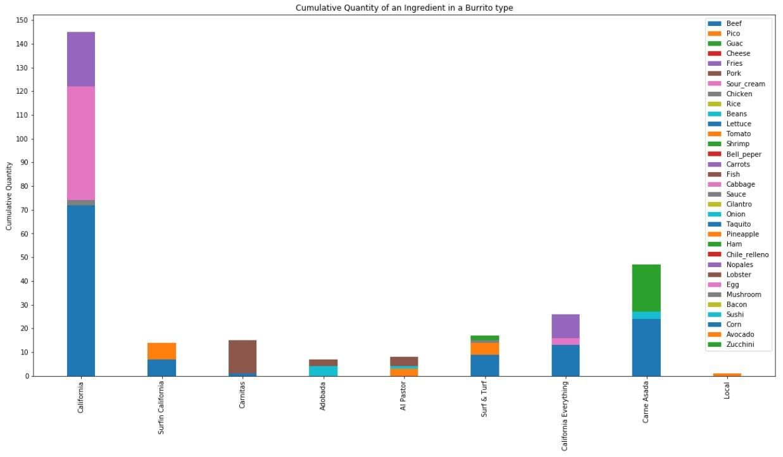
WHATINGREDIENTS ARE NECESSARY FOR THE MAKINGOF A PARTICULAR BURRITO?

Slide 15
INFERENCE
Clearly, we can see that for each of the famous burritos listed earlier, have a certain ingredients that are frequently used. For example, looking at the California burrito (the first Bar) we can see that corn, cabbage and fries are some ingredients which need to be used in order to make it a perfect burrito and public-loving.

Slide 16

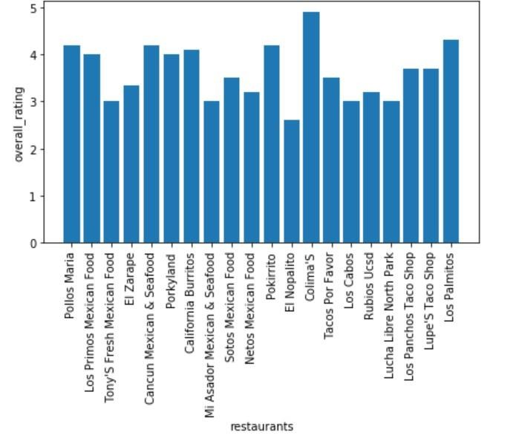
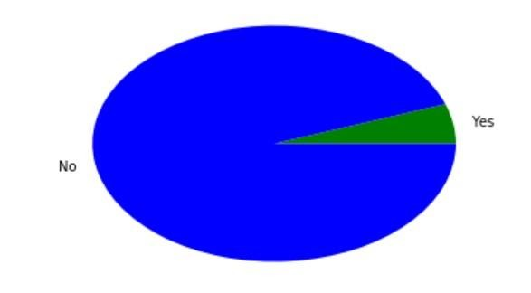
ARE COMPLEMENTARY CHIPS REALLY AFFECTING THE RATING OF THE RESTAURANT?

Slide 17
INFERENCE
It is seen that only a few restaurants are able giving away chips along with a burrito. Comparing these restaurants with the reviews that they get, we can see that, these places are kind of good as there is a collection of restaurants that near the 4 star rating. So even though less in number the restaurants serving chips along with burrito are actually increasing the quality of their dish. Hence we can conclude that chips can indeed be served with a burrito.

Slide 18

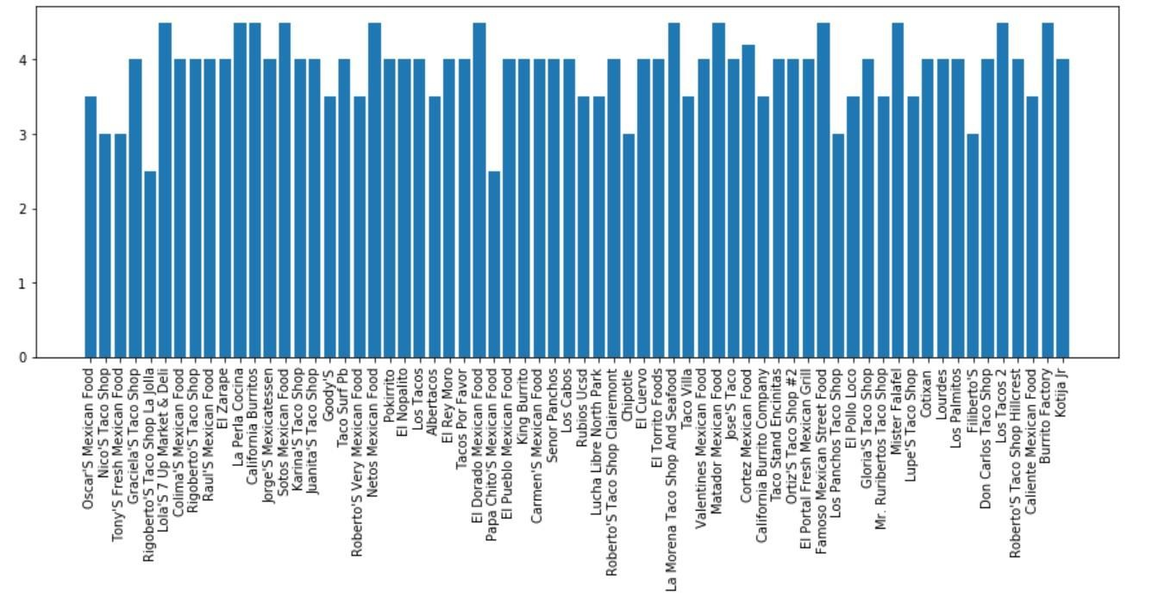
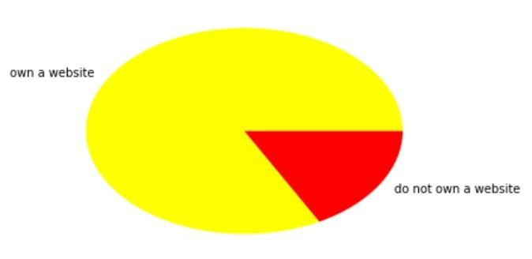
DOES MAINTAINING A WEBSITE ONYELP HAVE ANY RELATION WITHTHE YELP RATING OF A PARTICULAR RESTAURANT?

Slide 19
INFERENCE
Funny as it sounds, restaurants that cannot maintain their own website and maintaining a website on yelp have a better yelp rating.
Observing carefully, the restaurants have a rating of around 4(out of 5) .Since people normally search for a new restaurant to eat in general food-websites (yes, zomato too).
So if we register in the yelp website, we might also gain certain amount of popularity. It can be that because restaurants are paying yelp for the website, yelp is returning the favor by showing their rating a little higher (Maybe!). Moreover maintaining a website in earlier stages of business could also be quite expensive. Instead registering in Yelp website sounds like a better option

Slide 20
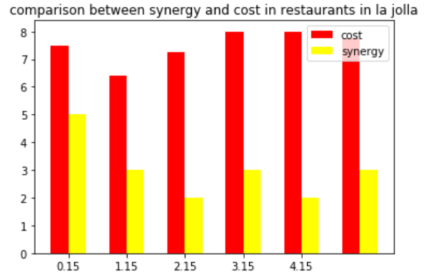
HOWARE THE COST TO SYNERGY RELATION OF THE BURRITO INOURCHOSEN AREA: LA JOLLA?

Slide 21
INFERENCE
Here synergy is given as a rating out of 5. But what is synergy? This basically tells us
how good the ingredients have mixed with each other.
This factor basically comments on the quality of burrito. In our chosen region, that is La Jolla, we can observe that most of the restaurants charge a high cost for a burrito with not that good synergy rating.
We can also comment that these restaurants are overpricing the customer. Obviously people in the region would have recognized that. So, In order to stay ahead in competition we sell better kind of burrito (with better synergy) at a reasonable cost.

Slide 22

CONCLUSION
We have finally completed inferencing some of the key factors that can help our restaurant business to start of kinda big. We have successfully come up with a place to set up our restaurant, La Jolla.
Also, we have seen that the overall rating given to burritos were given by critiques like Scott and Emily. So we decided to follow their opinion on any factor required.
Since burritos are famous in San Diego, we successfully decided the burritos which we would sell in our restaurant.
We then observed the chemistry between chips and burritos and found people actually preferred having chips with burritos.
We then saw how having a website in Yelp, also leads to a kind of better yelp rating. The reason being,
people go to food websites to find restaurants.
We finally saw synergy varied with cost and found how the restaurants in La Jolla were overpricing their burritos.

Slide 23
HYPOTHESIS TESTING
Mean cost total is 7.04828042328
Assumed mean cost total is 7.047
p-value of cost is 0.000680121461614

Slide 24

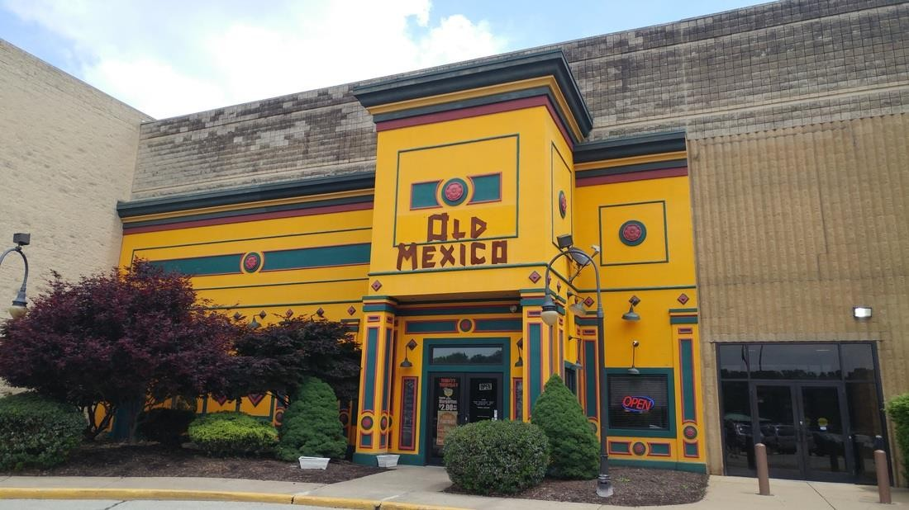
FINALLY THIS!!
Visit our new Restaurant!! It’s running successfully after implementing all our insights.

